Slide 1
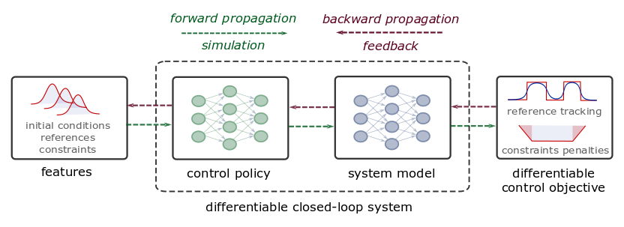
Differentiable Programming for Control
From data to explicit constrained control policy via differentiable optimization
Theoretical connection with MPC
Neural dynamical system models
Differentiable closed-loop model
Model-based policy optimization
Notes:
The conceptual methodology of DPC is illustrated here.
Assuming time series dataset obtained from the measurements of the system dynamics, in the first step, we perform system identification using a neural state-space model (SSM).
In the second step, we close the loop by combining the neural SSM with neural control law obtaining a differentiable closed-loop dynamics model fully parametrized by neural networks.
This allows us to leverage standard tools in deep learning to optimize the neural control laws by backpropagating the MPC loss function through the closed-loop dynamics.
Essentially this is a data-driven solution to multiparametric programming problems emerging from explicit nonlinear MPC.
Contrary to approximate MPC (aka imitation learning), DPC does not require supervision by an expert controller. Instead, a dynamics model is learned from a small dataset of system measurements, and the control law is then optimized offline by differentiating the learned system model.

Slide 2
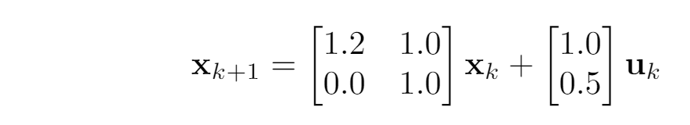
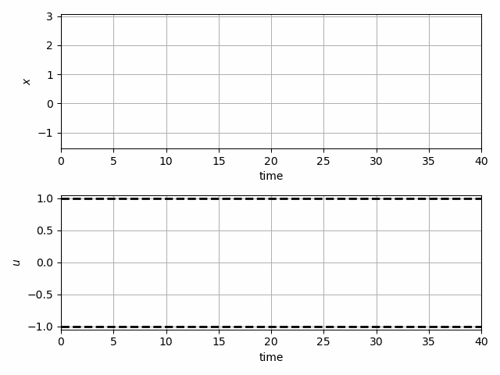
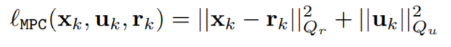
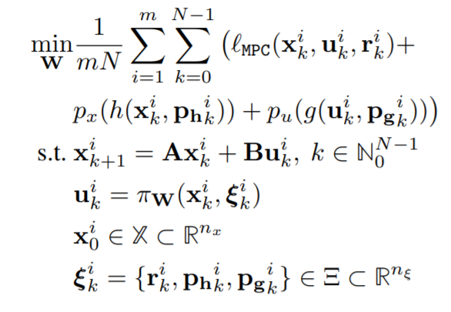
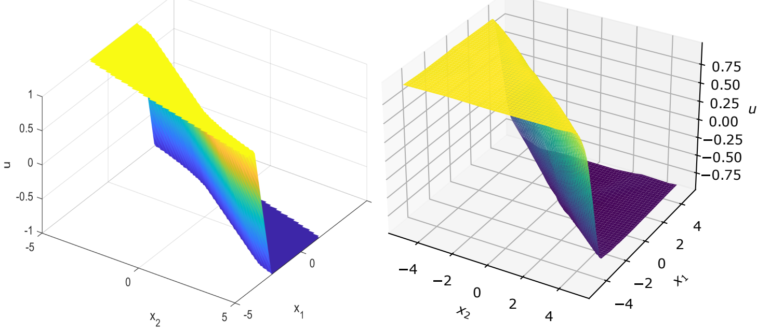
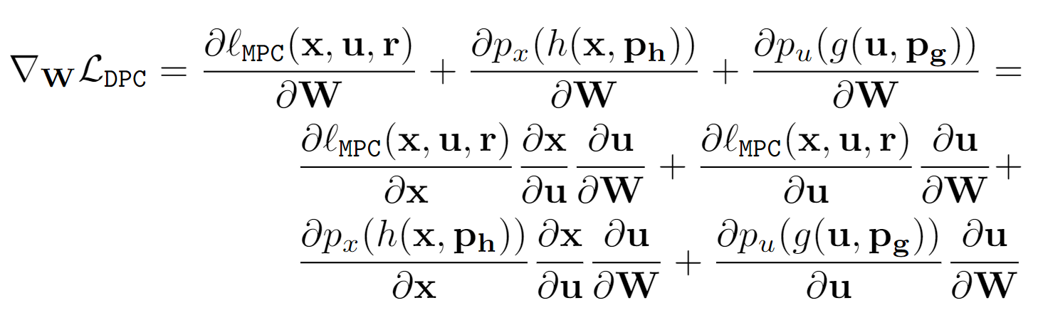
Differentiable Predictive Control
Problem setup
DPC formulation
DPC policy gradient
Jan Drgona, Aaron Tuor, Draguna Vrabie, Learning Constrained Adaptive Differentiable Predictive Control Policies With Guarantees https://arxiv.org/abs/2004.11184

Slide 3
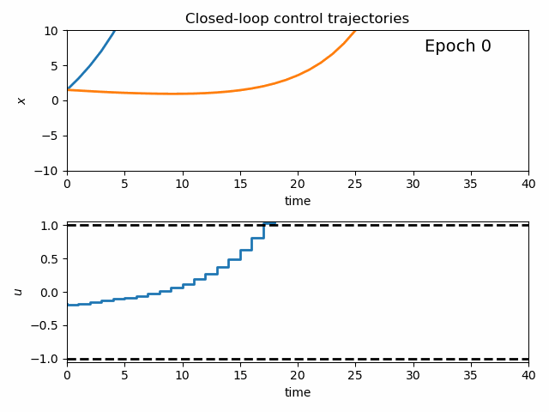
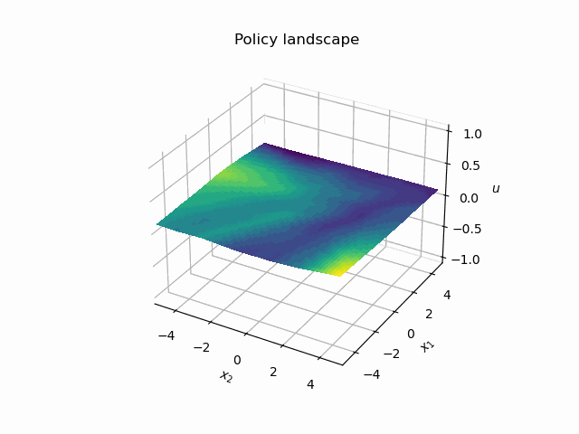
Dynamics of DPC Control Policy Learning
1341 learning parameters, 48.2 seconds offline training time on a CPU with 200 epochs.

Slide 4
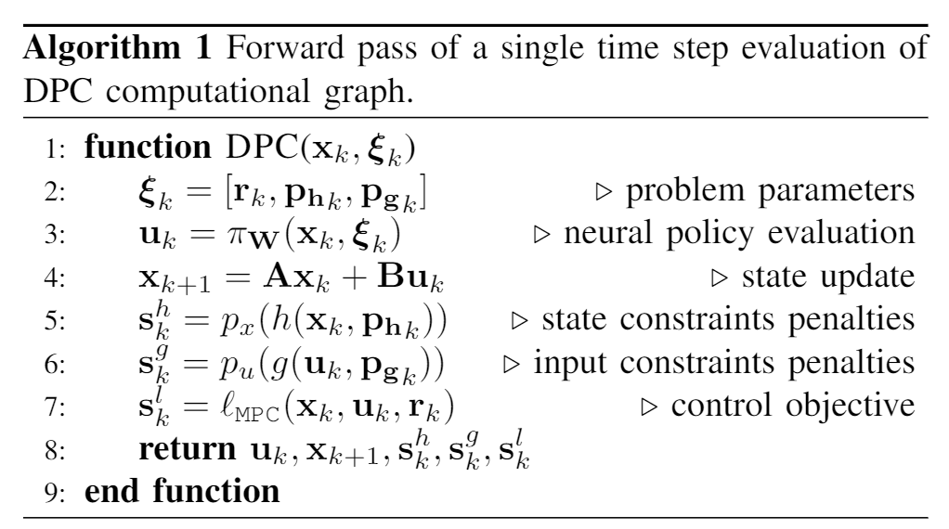
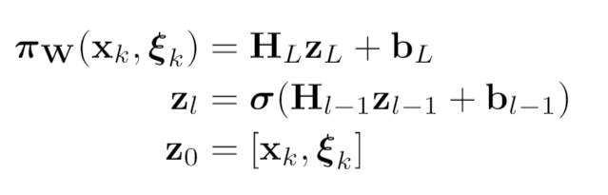
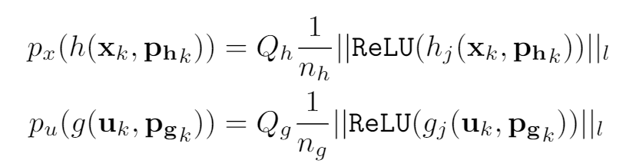
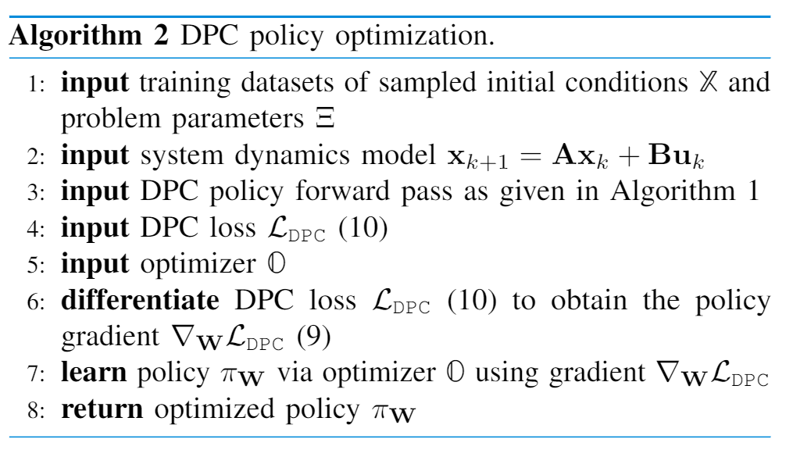
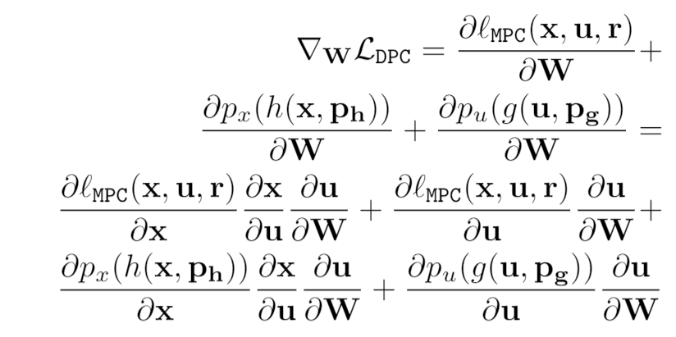
Model-based Policy Gradients of DPC
Policy
Reward function
Constraints
penalties
Direct policy gradients

Slide 5
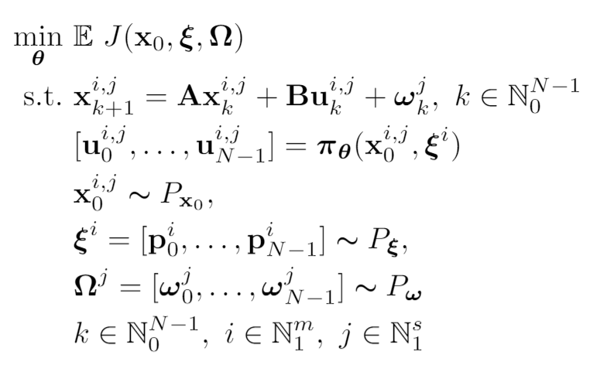
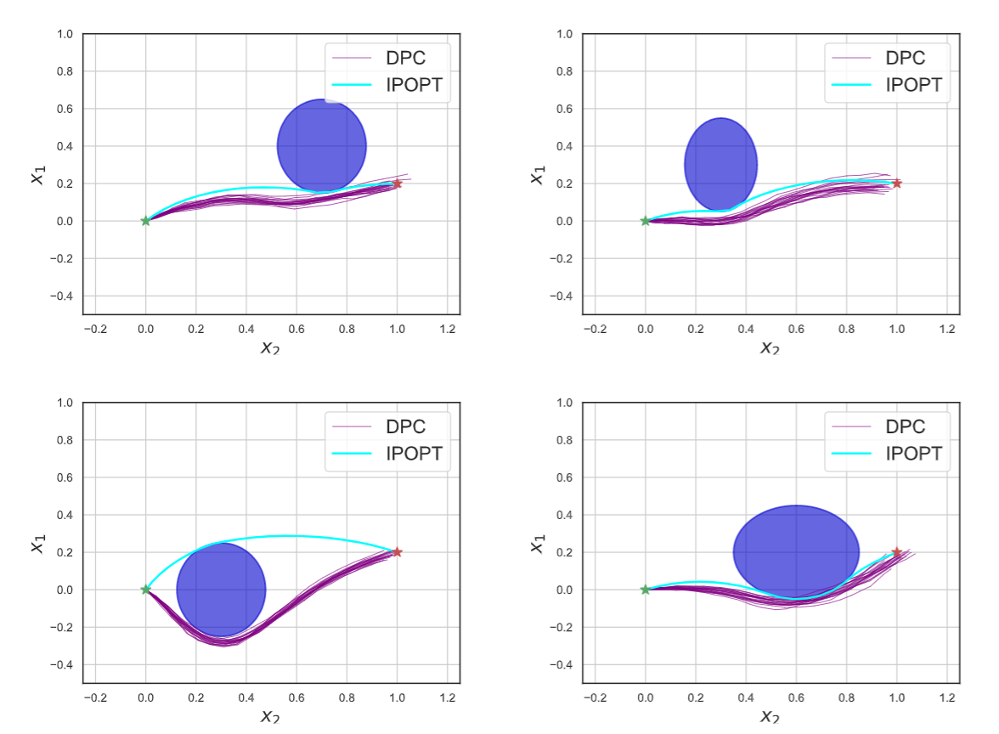
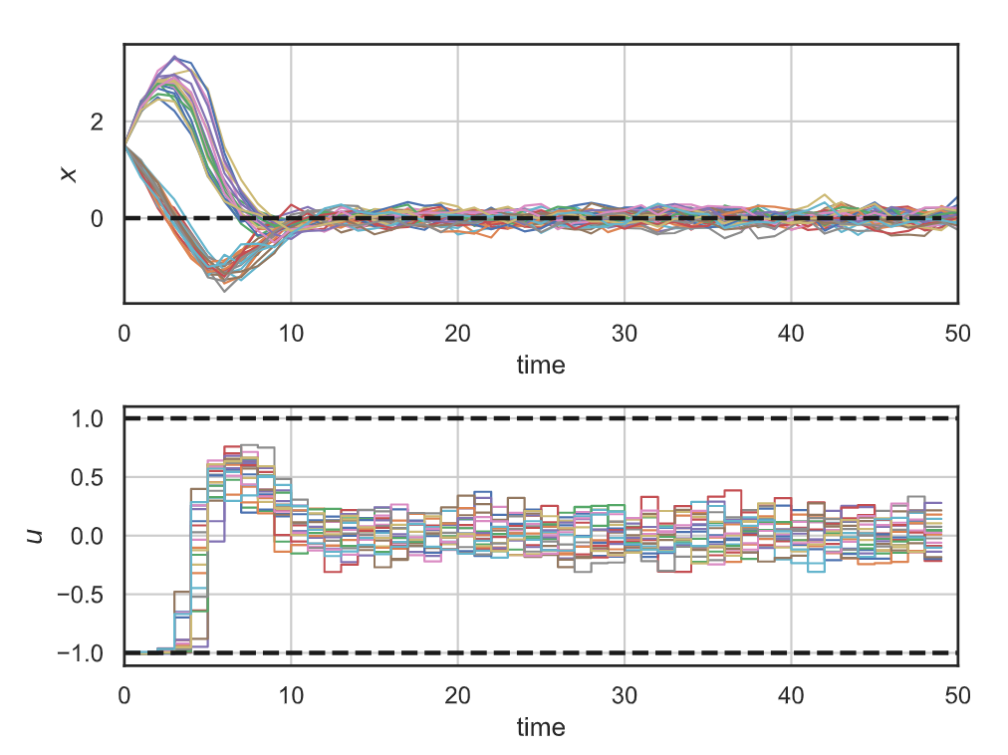
Stochastic Differentiable Predictive Control
Stochastic obstacle avoidance
Stochastic
formulation
Robustness
to state noise
Jan Drgona, Sayak Mukherjee, Aaron Tuor, Mahantesh Halappanavar, Draguna Vrabie, Learning Stochastic Parametric Differentiable Predictive Control Policies, arXiv:2203.01447, to appear at IFAC ROCOND 2022

Slide 6
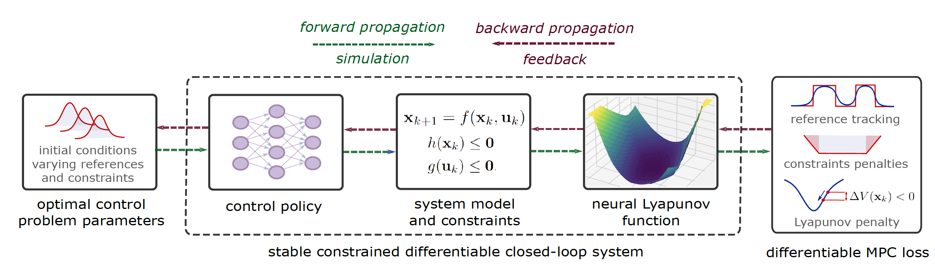
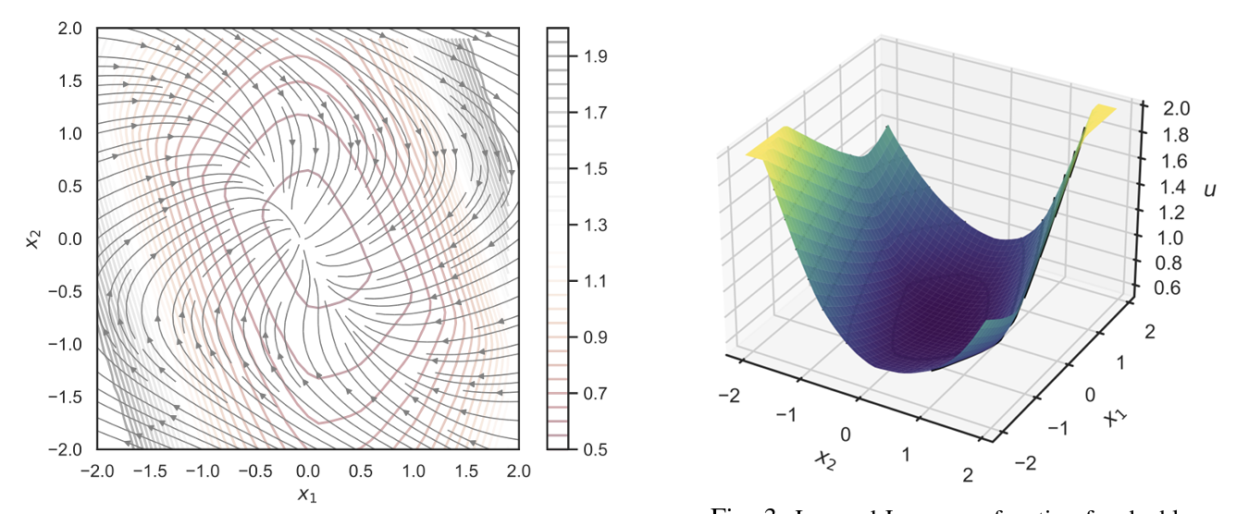
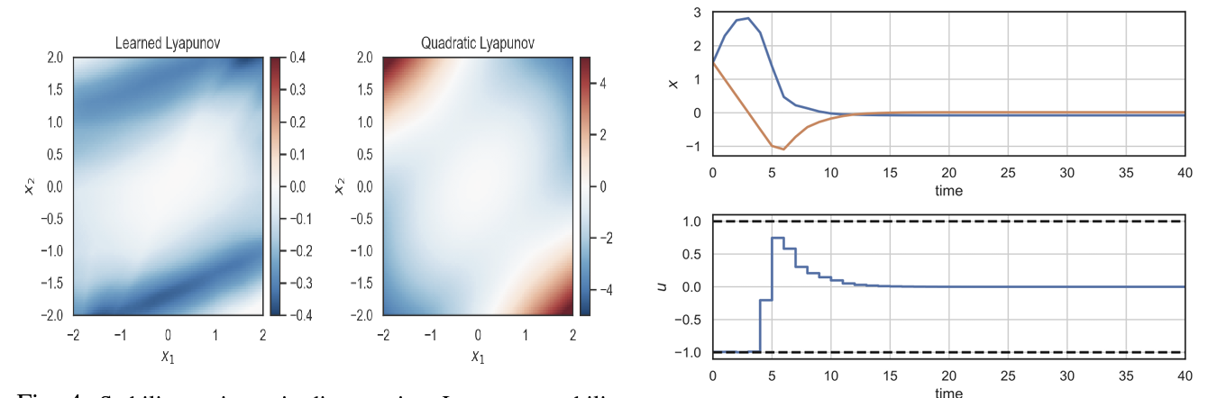
Learning Stable Policies via Neural Lyapunov Differentiable Predictive Control
Sayak Mukherjee, Ján Drgoňa, Aaron Tuor, Mahantesh Halappanavar, Draguna Vrabie, Neural Lyapunov Differentiable Predictive Control, arXiv:2205.10728, 2022

Slide 7
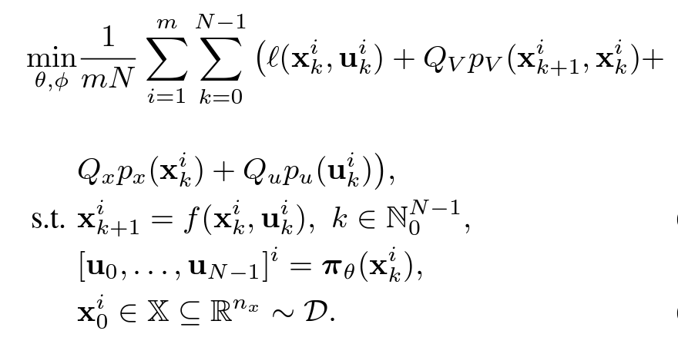
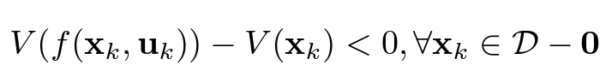
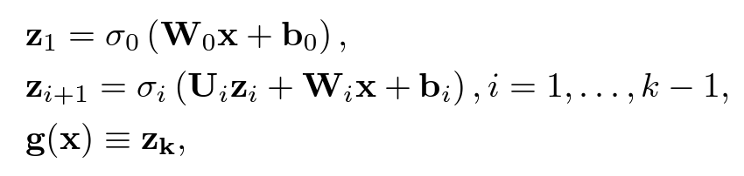
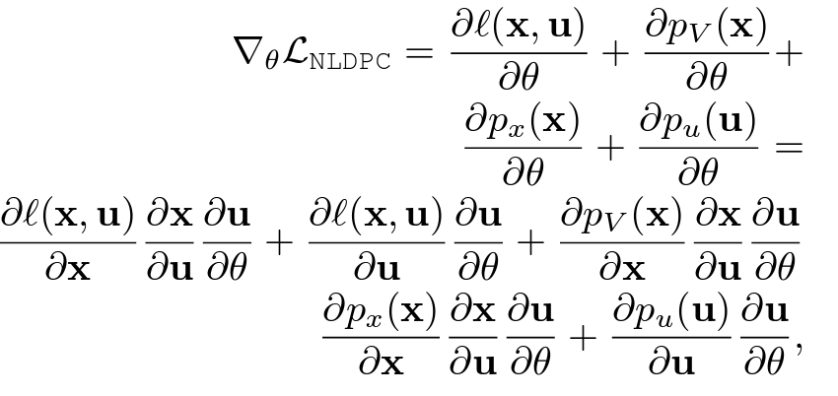
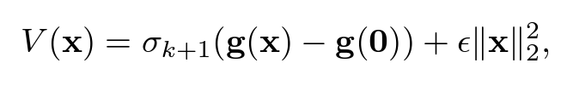
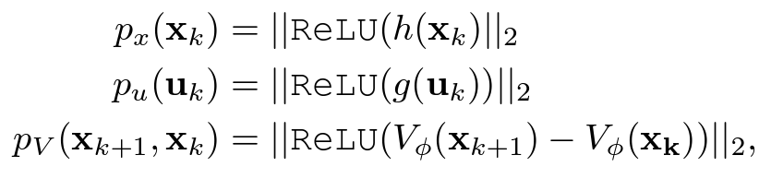
Learning Stable via Neural Lyapunov Differentiable Predictive Control
Neural Lyapunov Functions
Neural Lyapunov DPC
Lyapunov stability condition
Input-convex neural network
Trivial null-space via coordinate shift
Lyapunov regularization
Gaurav Manek, J. Zico Kolter, Learning Stable Deep Dynamics Models, NeurIPS 2019.
Sayak Mukherjee, Ján Drgoňa, Aaron Tuor, Mahantesh Halappanavar, Draguna Vrabie, Neural Lyapunov Differentiable Predictive Control, arXiv:2205.10728, 2022

Slide 8


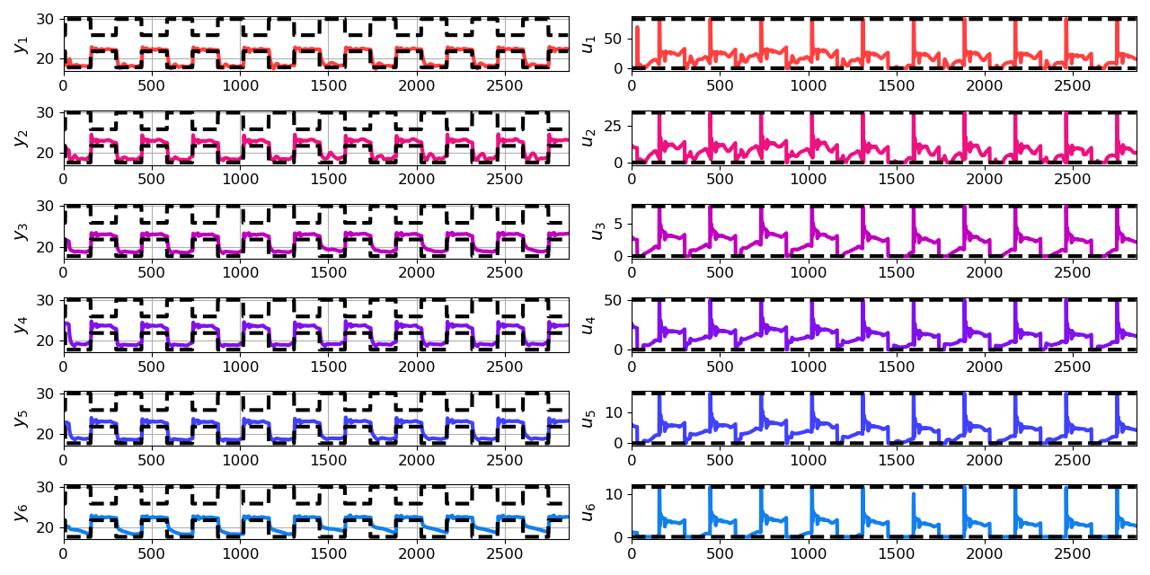
Economic DPC for Building Control
Neural state space dynamics model
MLP control policy architecture
Results
Handling multi-input multi-output nonlinear dynamics
Dynamic economic control objective
Parametric constraints
Jan Drgona, Aaron Tuor, Elliott Skomski, Soumya Vasisht, Draguna Vrabie, Deep Learning Explicit Differentiable Predictive Control Laws for Buildings, IFAC NMPC 2021

Slide 9
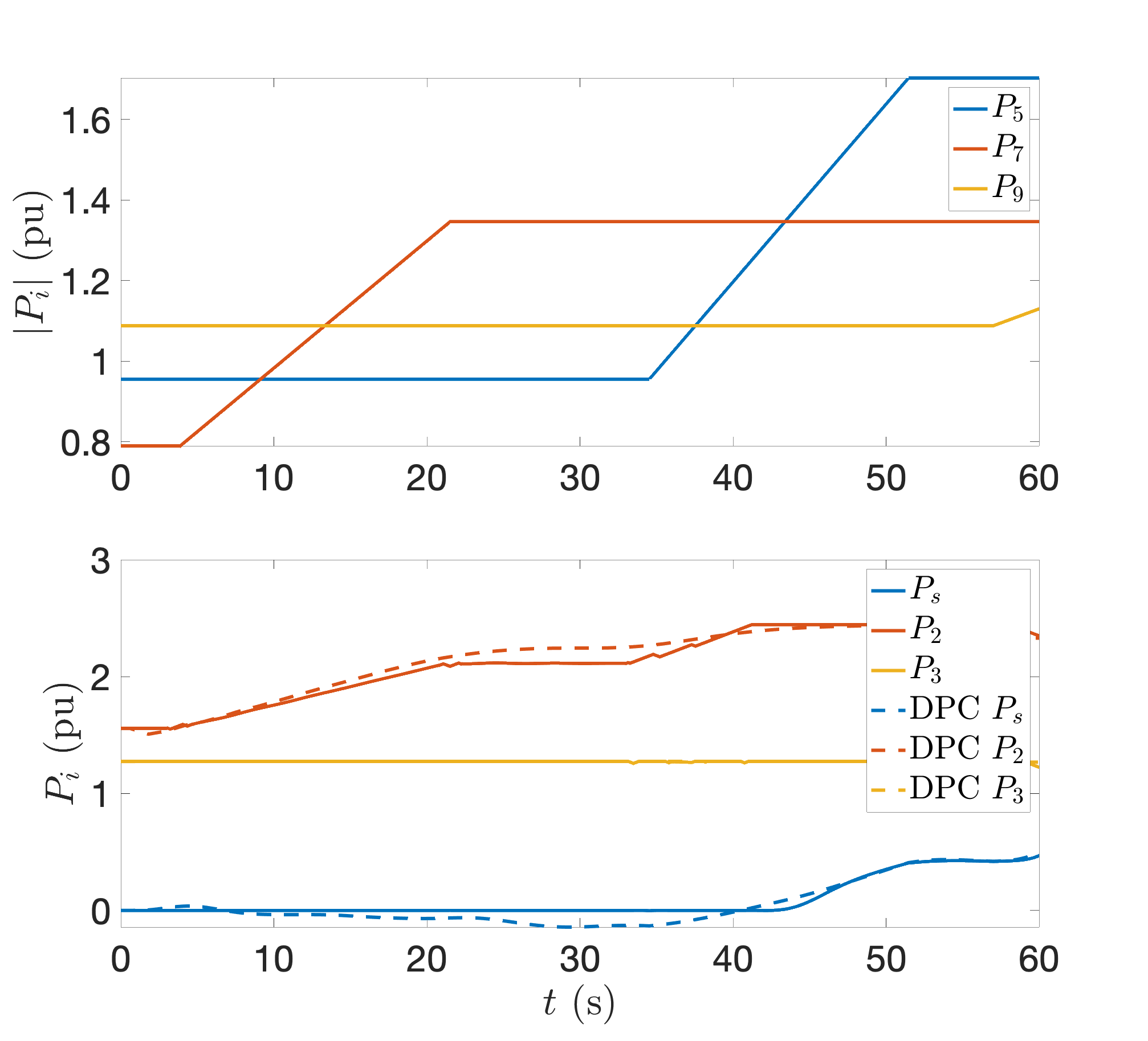
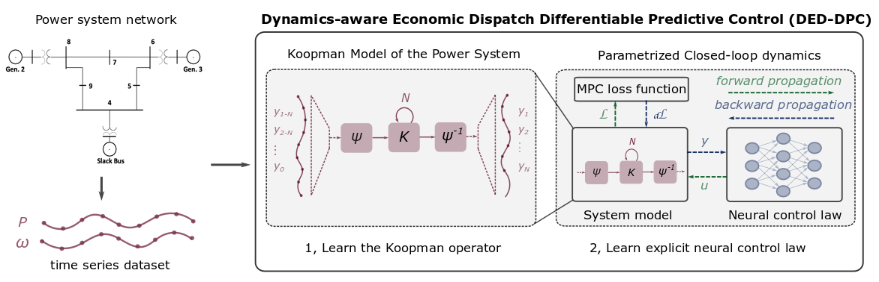
Koopman-based DPC for Dynamics-Aware Economic Dispatch
Problem: Current redispatch processes do not incorporate system stability concerns. Incorporating stability in redispatch is too complex and/or time-consuming
Solution: Machine-learning based dynamics-aware redispatch. Learn system dynamics for faster assessment.
KO dynamics model
CNN control policy framework
Results
5 orders of magnitude speed-up
Minimal loss in solution quality
Ethan King, Ján Drgoňa, Aaron Tuor, Shrirang Abhyankar, Craig Bakker, Arnab Bhattacharya, Draguna Vrabie, Koopman-based Differentiable Predictive Control for the Dynamics-Aware Economic Dispatch Problem, The 2022 American Control Conference
Notes:
Add waveform figure as a result – copy from previous slide replace discretize linearize with one block as iterative method

Slide 10
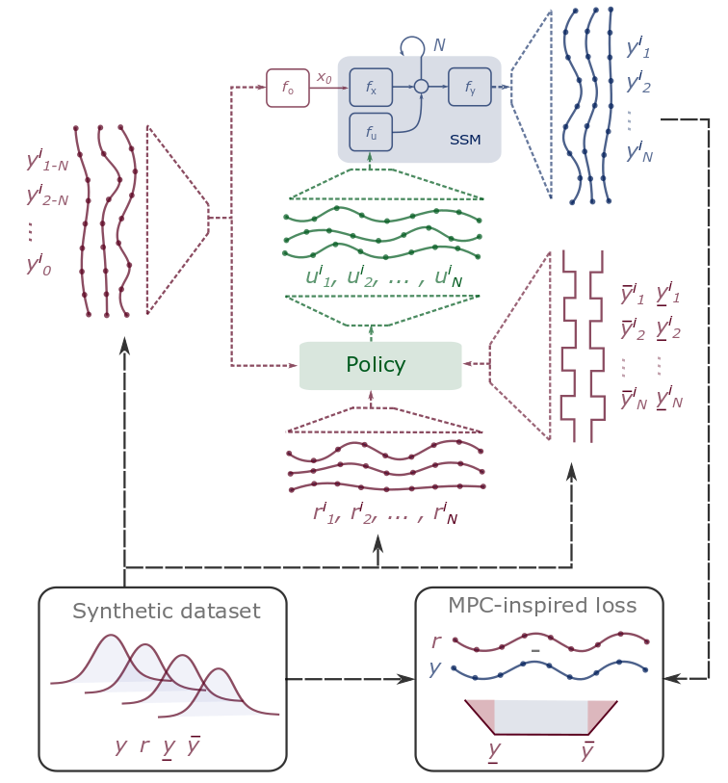
DPC Wrap Up
Differentiable Predictive Control
Differentiable system models
Explicit control policies
State and input constraints
Embedded implementation
Theoretical connection with MPC
Open-source Code
Neuromancer software package
https://github.com/pnnl/neuromancer
Structured linear maps in Pytorch
https://pnnl.github.io/slim/
Jan Drgona, et al., Differentiable Predictive Control: An MPC Alternative for Unknown Nonlinear Systems using Constrained Deep Learning https://arxiv.org/abs/2011.03699
Jan Drgona, Aaron Tuor, Draguna Vrabie, Constrained Physics-Informed Deep Learning for Stable System Identification and Control of Unknown Linear Systems https://arxiv.org/abs/2004.11184

